Slide 1
FIT3143 Applied 1
Julia Mallard, Nam Quang Tran

Slide 2
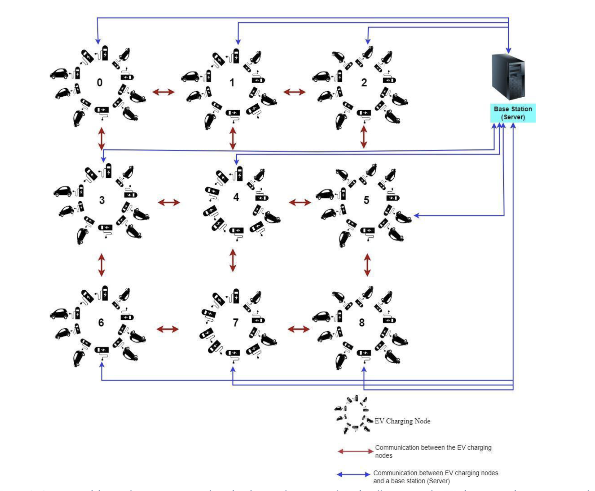

Slide 3
Task 1: Network topology

Slide 4
Network Topology Suitability Comparison Table
Topology | Connectivity | Scalability | Communication efficiency for neighbours | Suitable for EV grid?
Linear Array | Low | Moderate | Limited | No
Ring | Low | Moderate | Limited to 2 neighbours | No
Star | Centralised | Moderate | Poor for direct neighbour communication | No
Tree | Hierarchical | Good | Indirect for neighbours | No
Completely Connected | Very high | Poor | Excellent but excessive | No
Hypercube | High | Good | Good but complex | Less suitable
2-D Mesh | Up to 4 neighbours | Good | Excellent | Yes

Slide 5
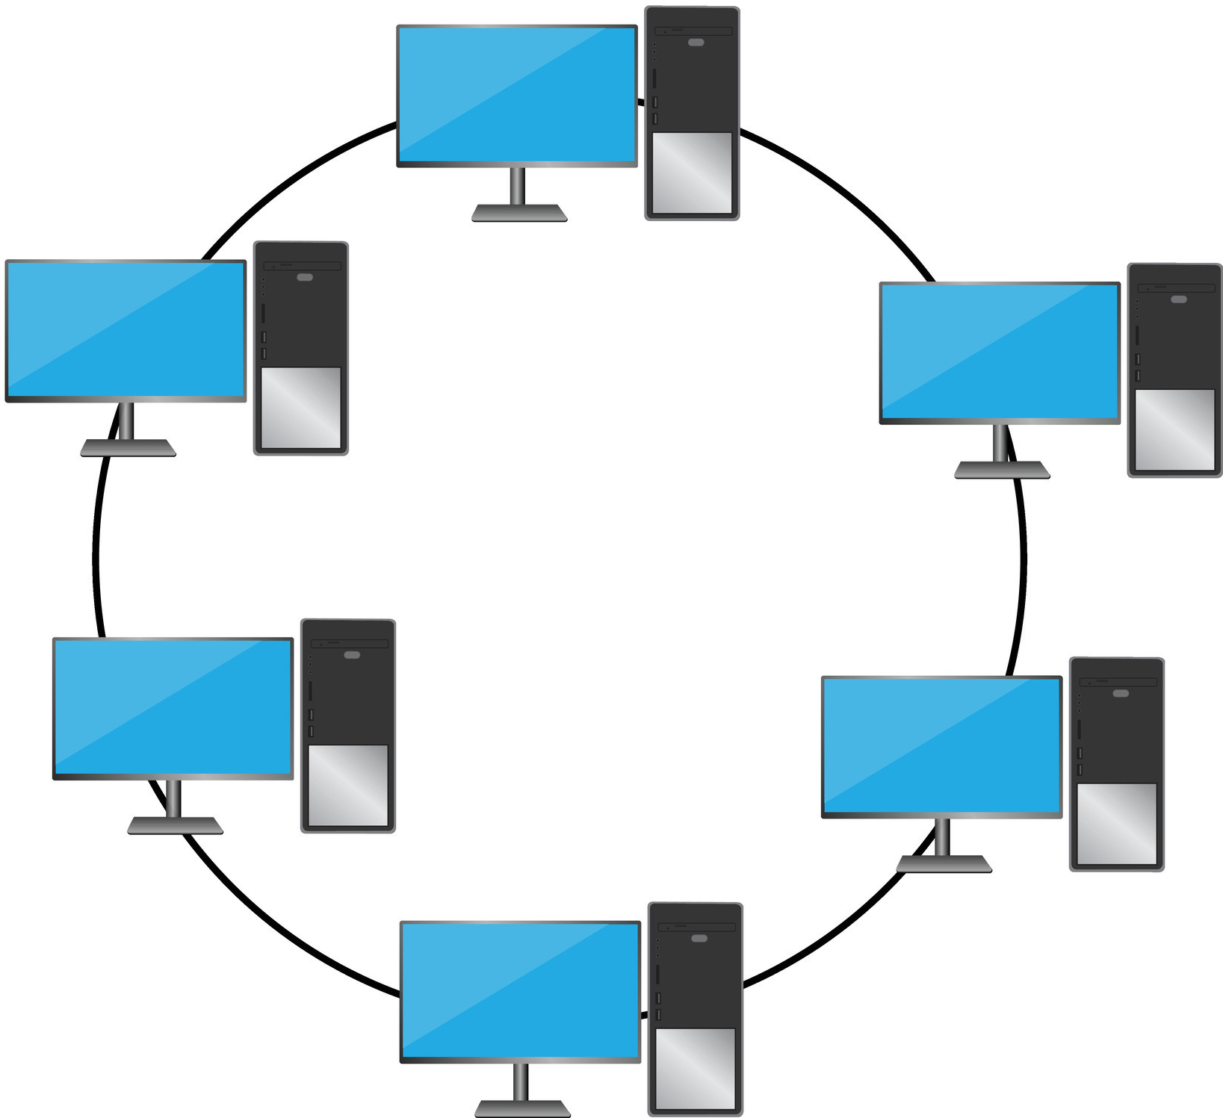
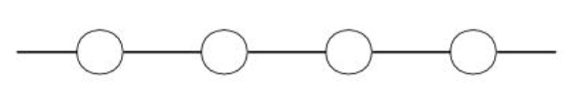
Network topologies from Week 5
Linear Array
Pros:
Simple design
Low number of Communication links
Low implementation cost
Cons:
Distant nodes = more hops
Edge nodes have only one neighbour
Not good 2D geographical representation
Ring
Pros:
Simple design
Each node has same number of neighbours
Alternative direction available
Cons:
Still only two neighbours per node
Unnecessary hops for geographically close neighbours
Not representative of a cartesian grid

Slide 6
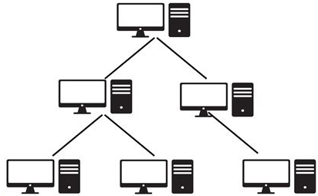
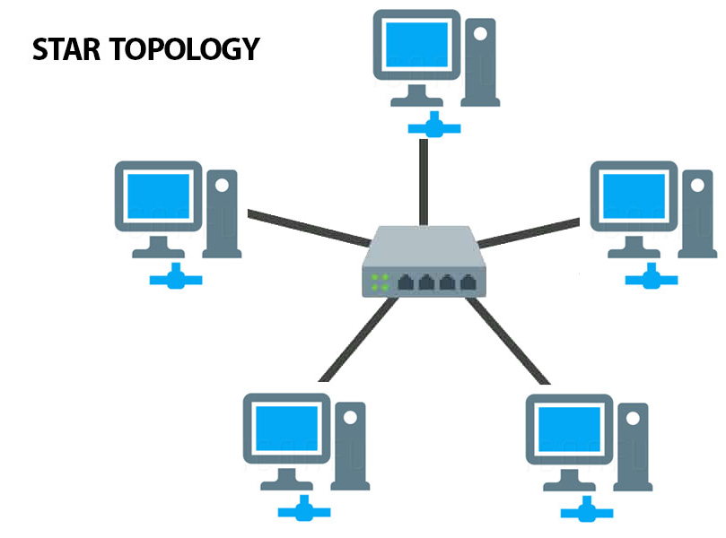
Network topologies from Week 5
Star
Pros:
Best for communication with central node
Cons:
Central node can become bottleneck
Doesn’t allow nodes to communicate with immediate neighboring nodes
Tree
Pros:
Good for systems with parent-child communication relationships
Cons:
Adjacent geographical nodes may require communicating through higher-level nodes
Upper-level nodes may become bottlenecks
Doesn’t reflect neighbour-neighbour grid communication

Slide 7
Network Topology Suitability Comparison Table
Topology | Connectivity | Scalability | Communication efficiency for neighbours | Suitable for EV grid?
Linear Array | Low | Moderate | Limited | No
Ring | Low | Moderate | Limited to 2 neighbours | No
Star | Centralised | Moderate | Poor for direct neighbour communication | No
Tree | Hierarchical | Good | Indirect for neighbours | No
Completely Connected | Very high | Poor | Excellent but excessive | No
Hypercube | High | Good | Good but complex | Less suitable
2-D Mesh | Up to 4 neighbours | Good | Excellent | Yes

Slide 8
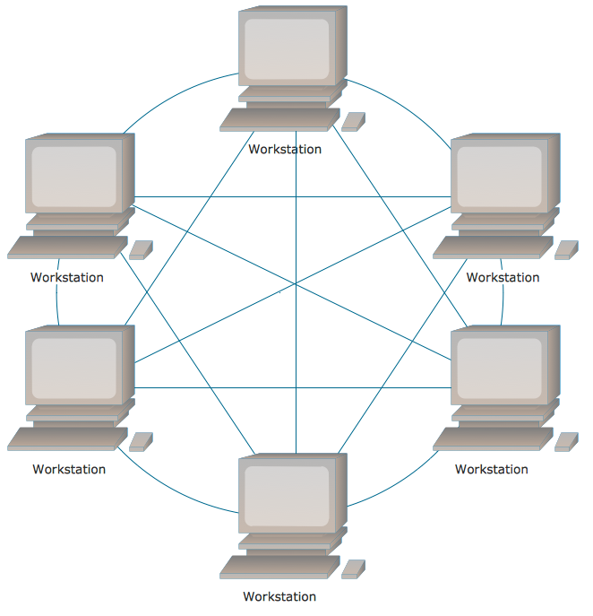
Network topologies from Week 5
Completely Connected
Pros:
Direct communication between all nodes
Low network diameter
High connectivity
Cons:
Number of communication links grows rapidly as number of nodes grows
High implementation and maintenance cost
EV charging nodes only need communication with immediate neighbours, so many communication links unnecessary

Slide 9
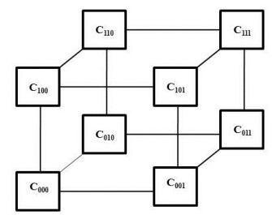
Network topologies from Week 5
Hypercube
Pros:
Low network diameter
Good scalability
Multiple communication paths
Cons:
Logical connections don’t map to geographical connections
Direct neighbours in the hypercube may not represent geographically adjacent nodes
More complex to implement

Slide 10
Network Topology Suitability Comparison Table
Topology | Connectivity | Scalability | Communication efficiency for neighbours | Suitable for EV grid?
Linear Array | Low | Moderate | Limited | No
Ring | Low | Moderate | Limited to 2 neighbours | No
Star | Centralised | Moderate | Poor for direct neighbour communication | No
Tree | Hierarchical | Good | Indirect for neighbours | No
Completely Connected | Very high | Poor | Excellent but excessive | No
Hypercube | High | Good | Good but complex | Less suitable
2-D Mesh | Up to 4 neighbours | Good | Excellent | Yes

Slide 11
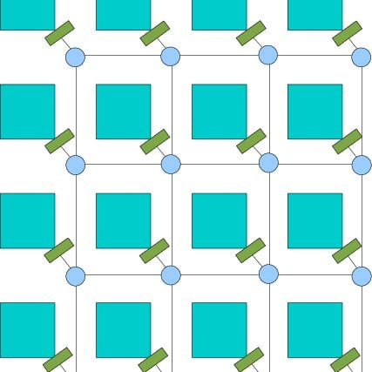
Network topologies from Week 5
2D Mesh
Pros:
Closely matches the cartesian grid
Direct communication between neighbouring nodes
Scalable by adding more columns/ rows
Requires less links than completely connected
Logical topology == geographical distribution
Cons:
More hops for communication with distant nodes
Network diameter increases as network grows
Edge and corner nodes have fewer neighbours than internal nodes

Slide 12
Selected Topology: 2d Mesh
Arranged in a cartesian grid
Communication with immediate adjacent nodes
Each node is connected to geographical neighbour
Avoids the unnecessary O(N²) connectivity of a fully connected network
Closest match to the physical and communication requirements of the EV wireless sensor network

Slide 13
Task 2: Architecture design

Slide 14
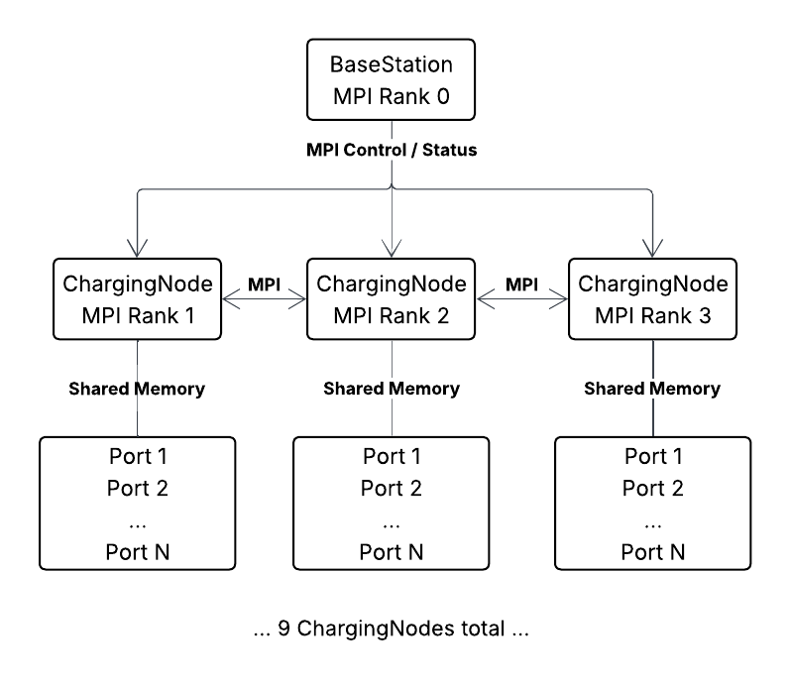
Simulation Software Architecture
9 ChargingNodes, 1 BaseStation, 10 MPI processes
MPI: distributed-memory communication between BaseStation and ChargingNodes
OpenMP: shared-memory parallelism across charging ports within each node
WSN: ChargingNodes communicate with neighbouring nodes
BaseStation: global monitoring and charging-node coordination
ChargingNode: local state, wireless communication and port management, N configurable charging ports per node
ChargingPort: individual EV charging simulation

Slide 15
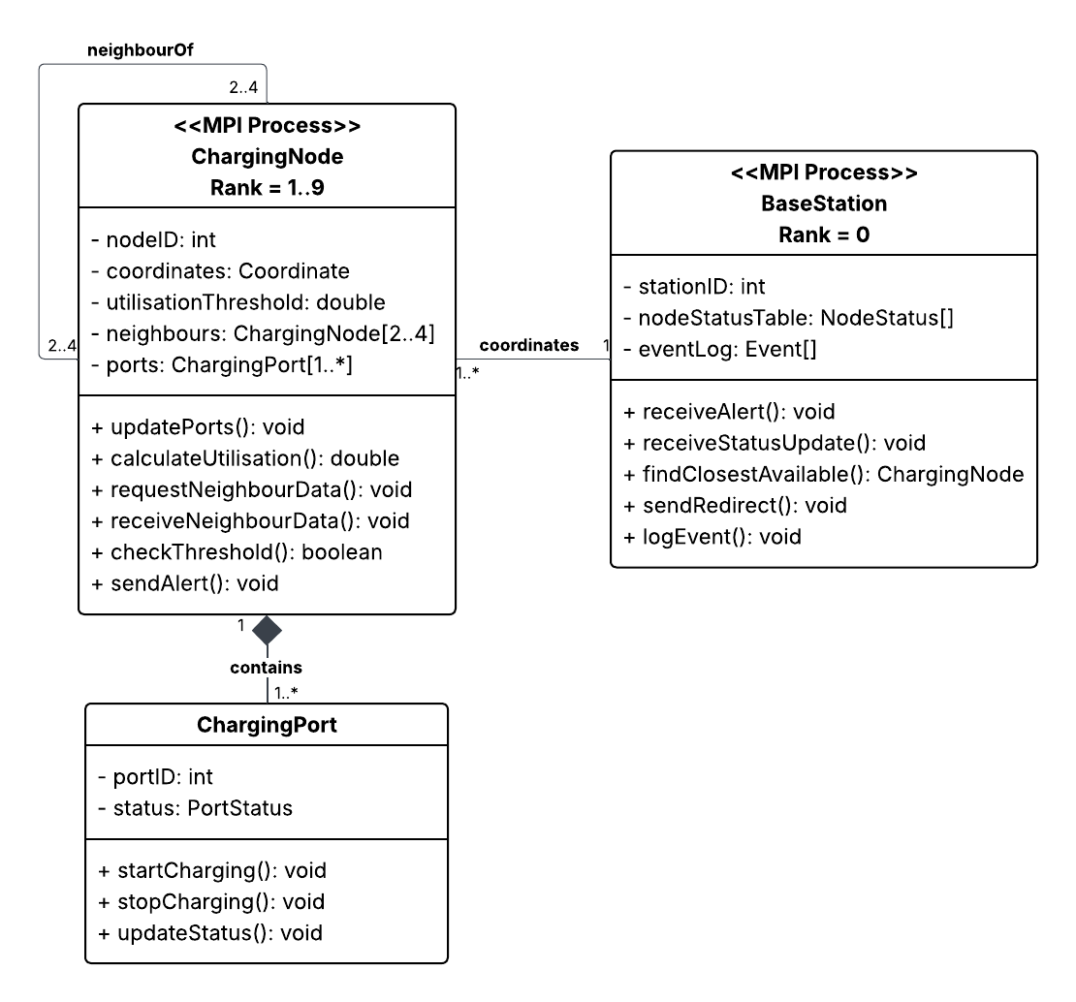
Static Structure Diagram
Components
1 × BaseStation
9 × ChargingNode
Each ChargingNode contains 1.. ChargingPorts*
ChargingNodes communicate with 2–4 immediate neighbours
Parallel Architecture
MPI processes model the distributed WSN
OpenMP threads process local ChargingPort updates
Hybrid distributed-memory and shared-memory parallelism

Slide 16
Mapping the WSN to MPI Processes
Logical WSN MPI Process
BaseStation → MPI Rank 0
ChargingNode 1 → MPI Rank 1
ChargingNode 2 → MPI Rank 2
ChargingNode 3 → MPI Rank 3
ChargingNode 4 → MPI Rank 4
ChargingNode 5 → MPI Rank 5
ChargingNode 6 → MPI Rank 6
ChargingNode 7 → MPI Rank 7
ChargingNode 8 → MPI Rank 8
ChargingNode 9 → MPI Rank 9
Each MPI process has private Memory
Inter-process communication: MPI messages
Total: 10 MPI Processes

Slide 17
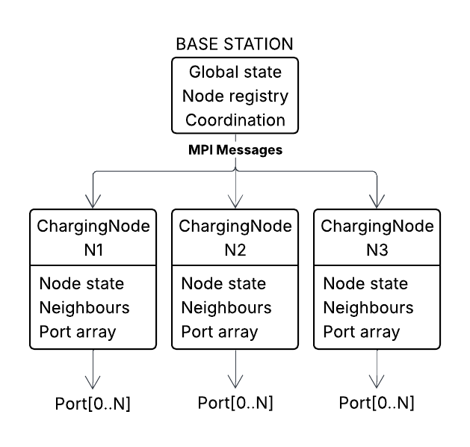
WSN and Charging Node Model
BaseStation represents the central coordinator.
Maintains:
global node status
congestion information
node availability
routing/redirect decisions
simulation-wide statistics
ChargingNode represents a WSN charging station.
Maintains:
node ID/location
local utilisation
charging-port states
neighbouring nodes
local congestion
communication state
ChargingPort represents an individual EV charging port.
Maintains:
availability
charging state
EV/session information
charging power
session duration

Slide 18
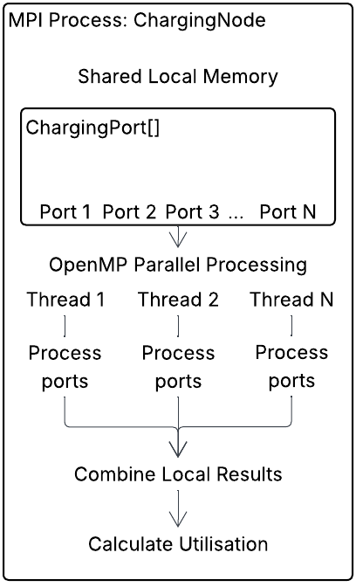
Hybrid Parallel Architecture:
MPI + OpenMP
Each ChargingNode is mapped to an MPI process and executes independently in distributed memory
Charging ports within a node are processed concurrently using OpenMP threads sharing the node's memory
MPI provides scalability across machines, while OpenMP exploits multiple CPU cores within each machine/process
MPI parallelism across nodes; OpenMP parallelism within nodes

Slide 19
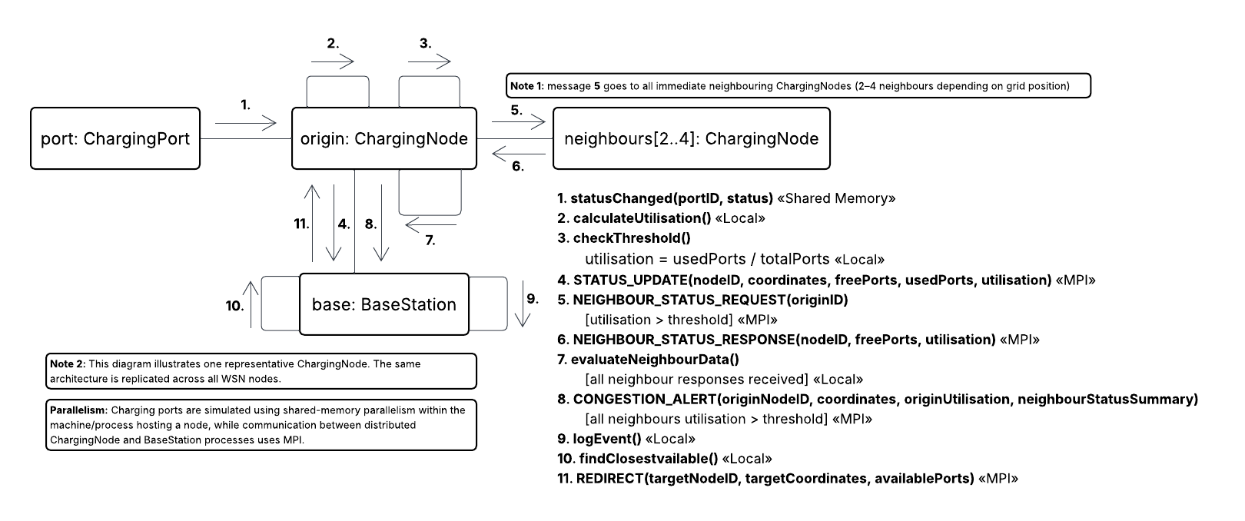
MPI Communication Between Simulation Components

Slide 20
Message Passing Protocol and Synchronisation
MPI Message | Sender | Receiver | Purpose
STATUS_UPDATE | ChargingNode | BaseStation | Report node/port state
NEIGHBOUR_STATUS_REQUEST | ChargingNode | Immediate neighbours | Request current node state
NEIGHBOUR_STATUS_RESPONSE | Neighbour | Origin ChargingNode | Return node state
CONGESTION_ALERT | ChargingNode | BaseStation | Report local/nearby congestion
REDIRECT | BaseStation | ChargingNode | Instruct node to redirect EV
Evaluate neighbour state
Neighbour communication
→
MPI_Isend()
MPI_Irecv()
→
Local computation
→
→
MPI_Waitall()
Global network utilisation
ChargingNode ranks
local utilisation
---------------->
MPI_Reduce()
→
BaseStation
→

Slide 21
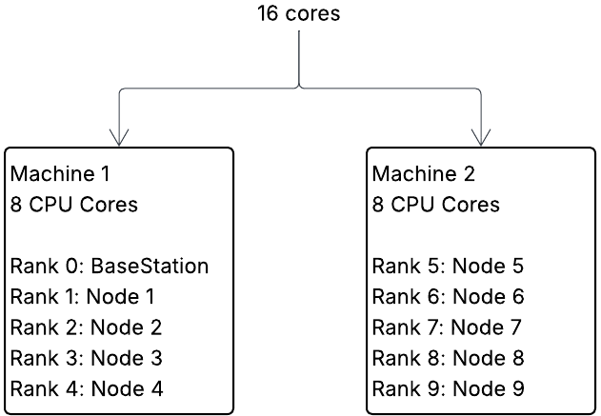
Cluster Deployment and Process Mapping
CPU execution model
MPI: one process per BaseStation/ChargingNode
OpenMP: threads within each ChargingNode process
Shared memory: ChargingPorts are local to their ChargingNode
CPU affinity: configured to prevent excessive thread oversubscription
The number of OpenMP threads is configured to avoid oversubscribing physical CPU cores

Slide 22
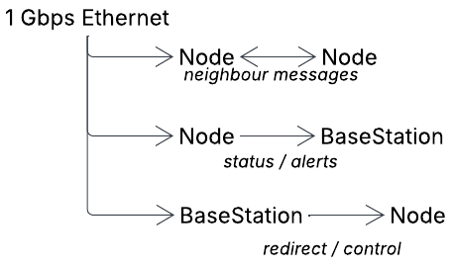
Network Requirements
BW ≈ N × d × f × S
where:
N = number of ChargingNodes
d = average number of communicating neighbours
f = messages per second
S = message size
d is limited to immediate neighbours and S is small because messages contain node/port state and control information
Expected traffic is well below the 1 Gbps link capacity
Actual bandwidth utilisation, latency and communication overhead will be measured experimentally
Communication | MPI mechanism | Purpose
Node → Node | MPI_Isend/Irecv | Neighbour status exchange
Node → BaseStation | MPI_Isend | Status/congestion reporting
BaseStation → Node | MPI_Isend | Control/redirect
Nodes → BaseStation | MPI_Reduce | Global statistics

Slide 23
Architecture Summary
1. Distributed Memory
MPI distributes BaseStation and ChargingNode processes across cluster machines.
2. Shared Memory
OpenMP concurrently processes ChargingPorts within each ChargingNode.
3. WSN Communication
ChargingNodes exchange neighbour status and congestion information through MPI.
4. Central Coordination
BaseStation aggregates global state and issues control/redirect decisions.]
1 BaseStation + 9 ChargingNodes + N ChargingPorts/node | 10 MPI processes | 2 × 8-core machines | 1 Gbps interconnect

Slide 24
Task 3: Analysis

Slide 25
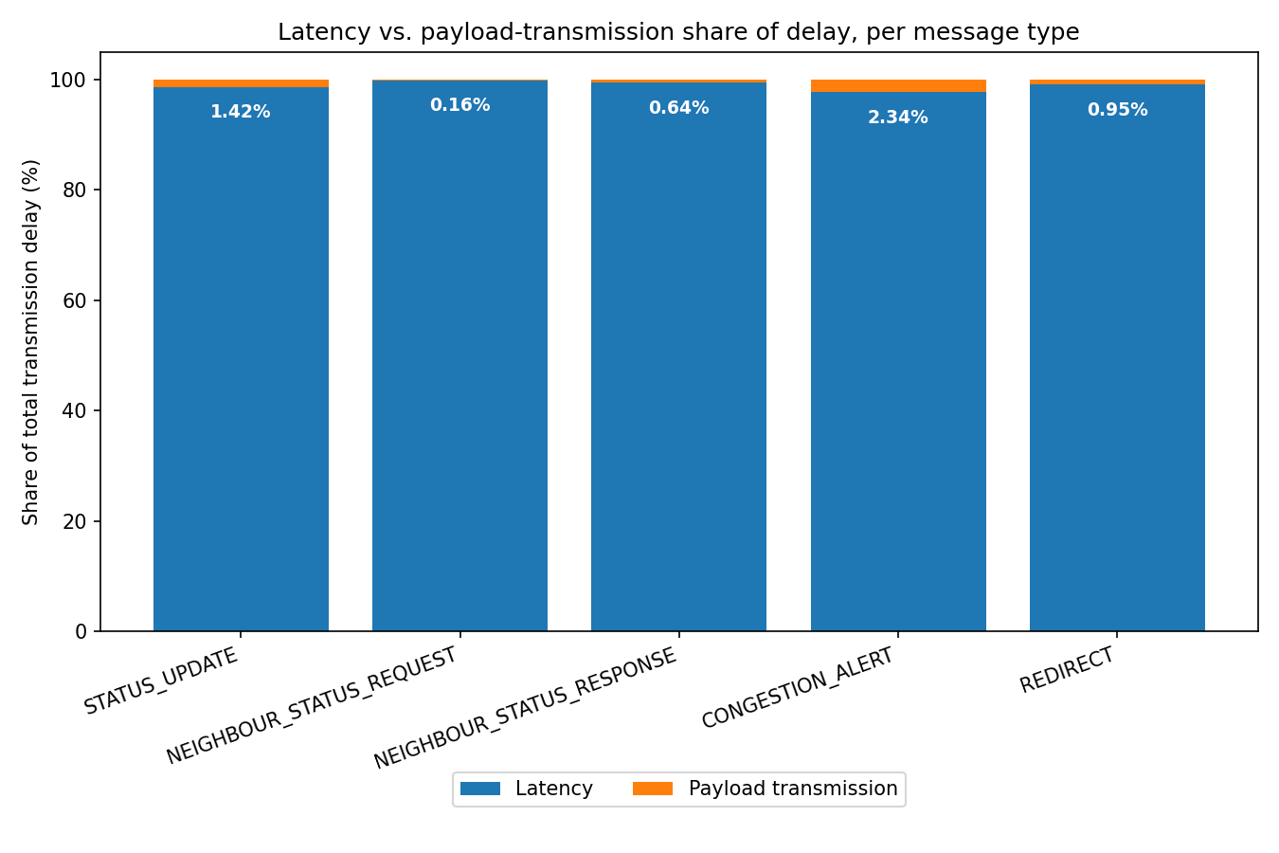
Communication analysis
Due to the high speed 1 Gbps, the fixed latency overhead contributes much more to the transmission delay than the message transmission time. I.e, if the communication time = a + b*m, where a, b and m are the latency time, bandwidth and message size respectively, for a reasonable value of a (a≈20 microseconds), the a value dominates.
This is because for our MPI messages, the message sizes will be very small, at the most 60 bytes, meaning that our 1 Gbps link will send the payload in a fraction of a microsecond.
This means the latency time makes the bulk of the transmission latency, meaning the size of the payload does not matter as much.
This means we can worry about the Big O complexity of how many messages are being sent, rather than what is being sent between, and given the latency value stays consistent, it should just act as a multiplicative scalar, the difference between 20 microseconds or 50 microseconds does not change the scale of the transmission delay.
However, we cannot assume that latency will be consistent, and it will depend on the network conditions.
Assuming latency ≈ 20 microseconds

Slide 26
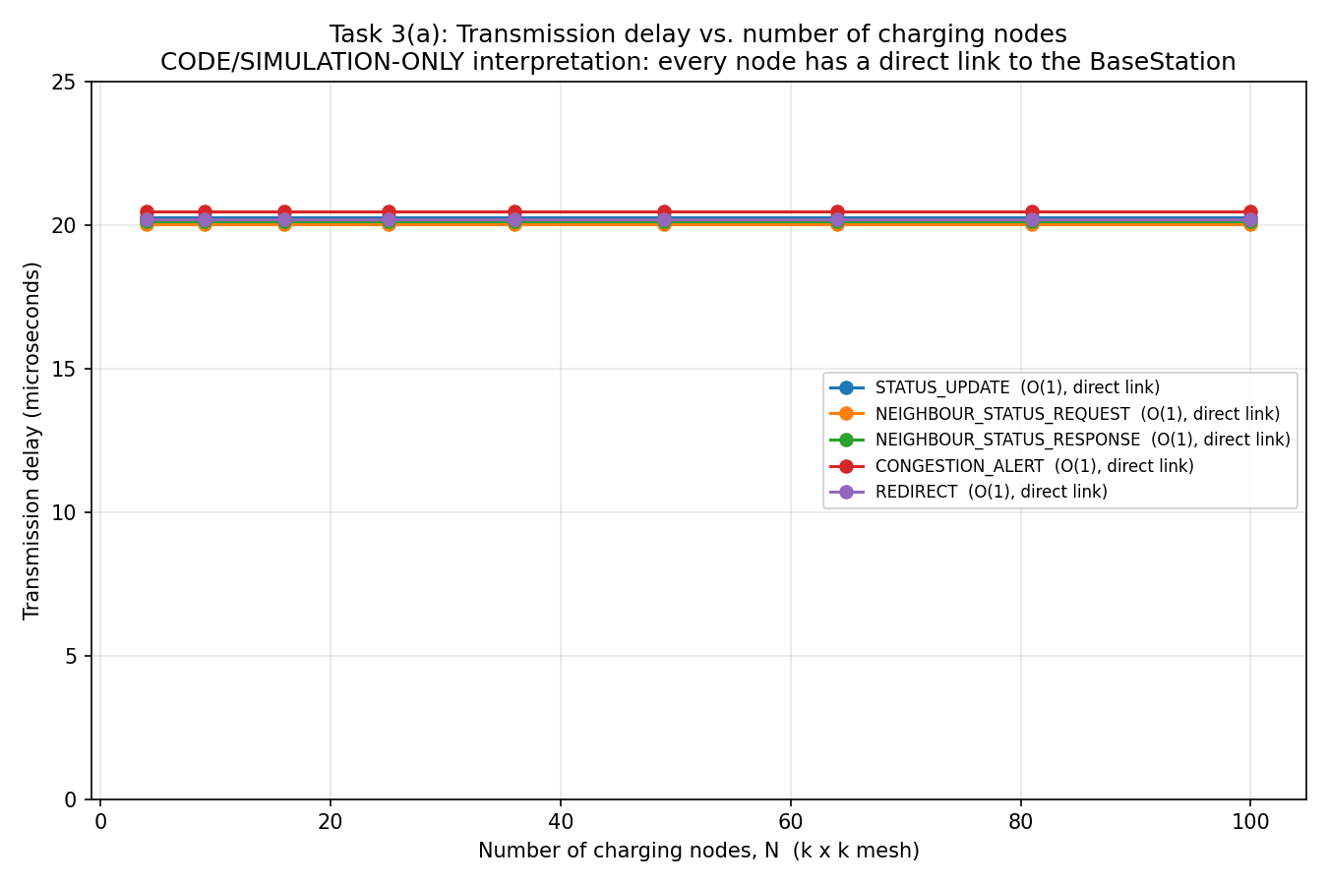
Transmission delay vs number of charging nodes (theoretical)
When each node is connected to neighbouring nodes as well as the base station.
STATUS_UPDATE, NEIGHBOUR_STATUS_REQUEST, NEIGHBOUR_STATUS_RESPONSE, CONGESTION_ALERT and REDIRECT are all O(1).
  Fixed payload size
  Fixed number of recipients (at most 4)
  Fixed hop count (1, from node straight to BaseStation)
Because each node is connected to the base station with a direct link, messages that go from node to base station that would normally require traversing other nodes to get to the base station take O(1) time.,
Data assumes constant latency of 20 microseconds

Slide 27
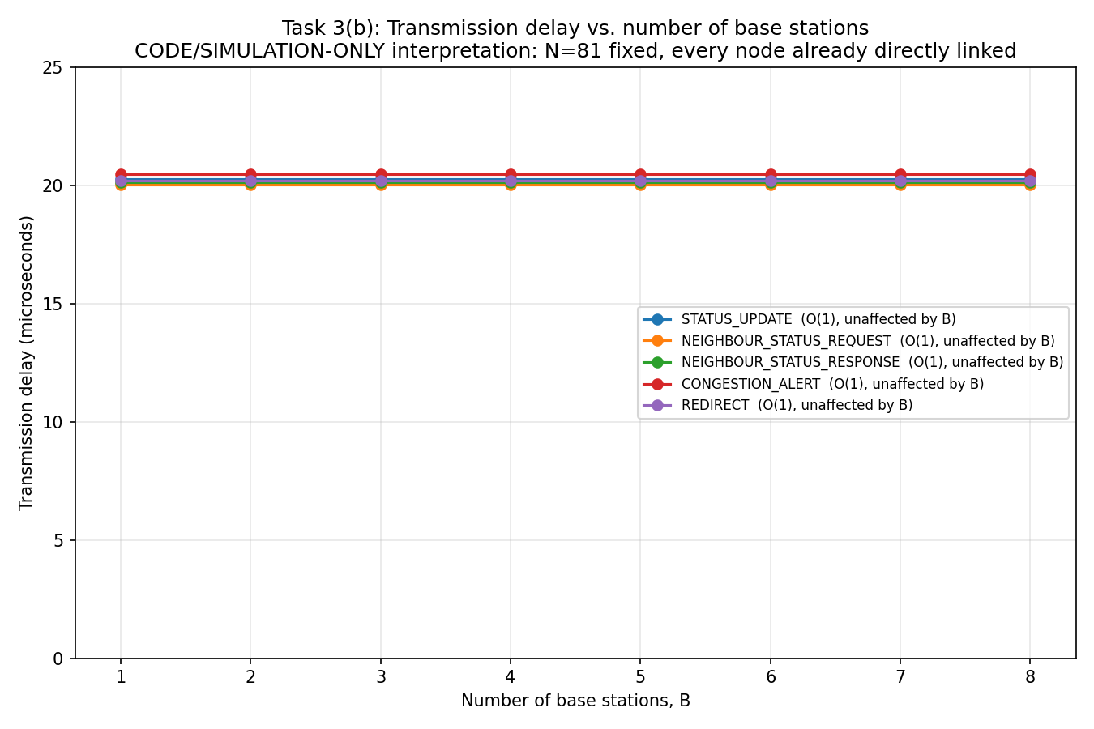
Transmission delay vs number of base stations (theoretical)
Very similar picture, because each node is directly connected to a base station, the number of base stations does not matter, as there will always be that direct connection.
Data assumes constant latency of 20 microseconds

Slide 28
Feasibility of direct link from base station to every node
Creating a link from each node to the base station is very easy in a simulated code model, as MPI makes it very easy to implement a link between threads. It is simple to pass messages from ranks 1-... to rank 0, if hardware is not necessary to keep in mind.
For a relatively small network, 3x3 for example, connecting each base station to a node would most likely be not too difficult, however, transmission delay would not become a big issue until the number of nodes is significantly large, such as a state-wide EV charging network.
The ironic thing is, the problem appears when the number of nodes becomes large enough that not only is it no longer feasible to link every node to a base station.
This means we have to consider the design we cannot create a link for each node, meaning the number of nodes and base stations actually creates a meaningful difference.
We can consider the earlier graphs and scenario a “theoretical” example, where we only look at MPI code, and ignore hardware limitations.

Slide 29
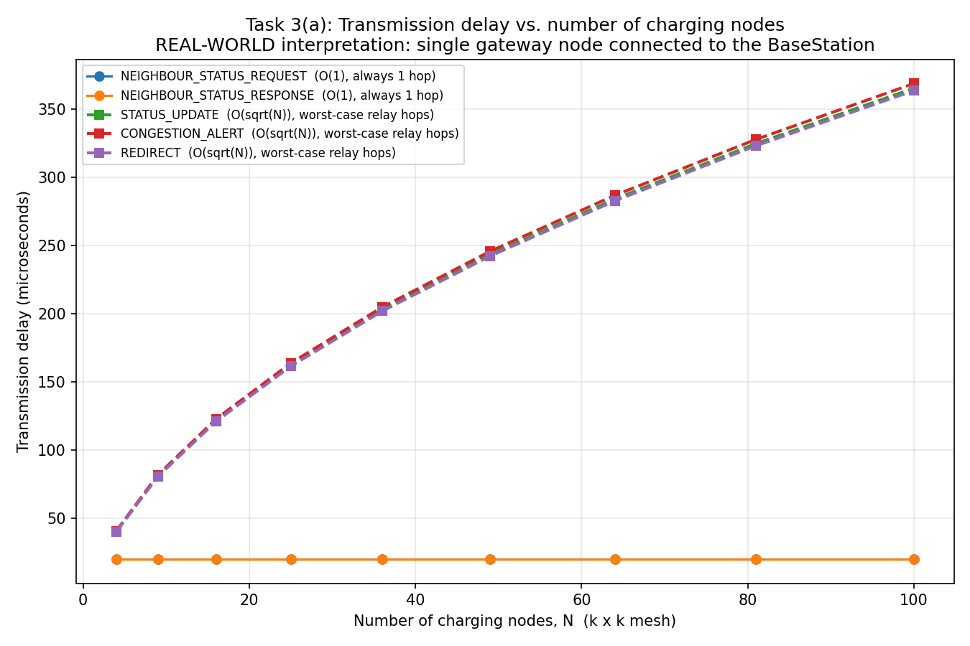
Transmission delay vs number of charging nodes (“real-world”)
NEIGHBOUR-STATUS-REQUEST and NEIGHBOUR_STATUS_RESPONSE stay O(1), as they only need to ping neighbours, and not the base station.
STATUS_UPDATE, CONGESTION_ALEART AND REDIRECT become O(sqrt(N)), because they need to traverse a worst case before getting to the base station. It is not O(n), which it would be in a line topology for example, it is square rooted because the topology forms a 2D mesh.
Data assumes constant latency of 20 microseconds

Slide 30
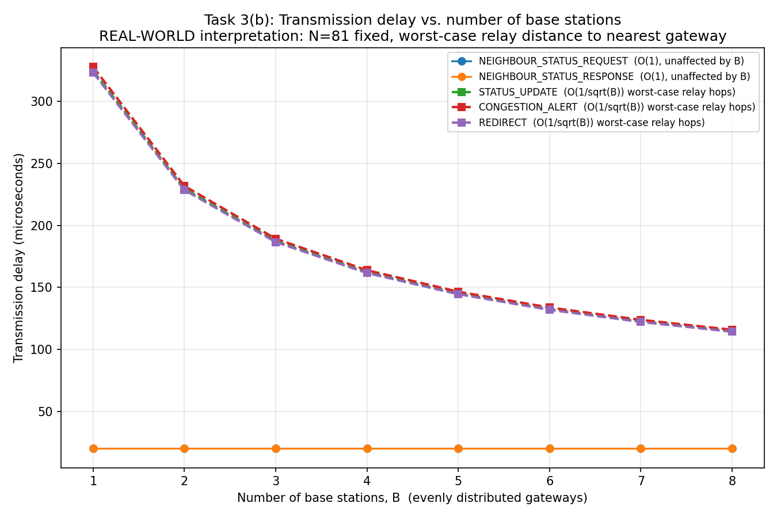
Transmission delay vs number of base stations (“real-world”)
The number of base stations reduces the hops (and in turn transmission delay) of the three messages that depend on B and N (the messages that go from node to base station), by sqrt(B).
Why not B? Because each base station should cover an area of N/B nodes, but that is area, not distance, the distance that is reduced, only scales back by a factor of sqrt(B), meaning that there is diminishing returns when adding more and more base stations.
Data assumes constant latency of 20 microseconds

Slide 31
Beyond node and base station count
Other than node and base station numbers, another factor that could impact transmission delay include the number of charging ports, growing number of EVs and a higher charging frequency.
Ultimately, all of these factors would increase message frequency:
A larger number of charging ports would create more status messages as there are more ports that can communicate
More EVs on the road means the ports at the nodes are more busy, switching from free to occupied more often.
Higher charging frequency has the same result as more EVs.
Despite not changing transmission delay, they do add to message frequency, which could can affect a base station if there are too many messages coming in at the same time to process.

Slide 32
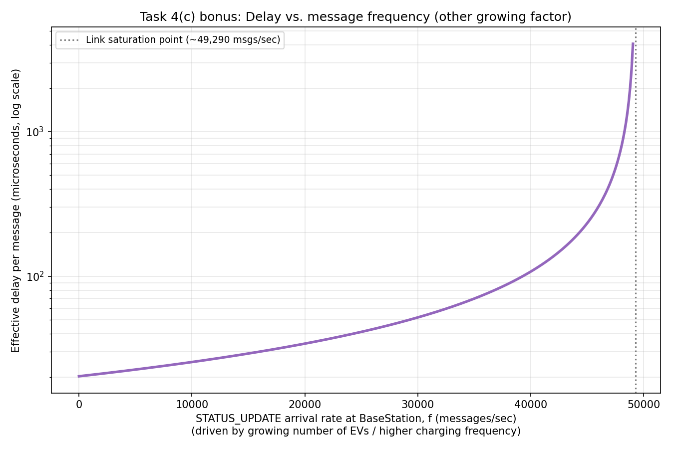
High message frequency causing queuing at base station
Using the M/M/1 queuing formula, we can simulate the potential bottleneck that can occur if too many messages are sent, causing transmission time (transmission delay + queuing time) to skyrocket. Adequate load handling should be done here, move base stations would be ideal.

Slide 33
Conclusion
We believe the 2D mesh topology to be the strongest, most appropriate and the topology most representative of the real world.
Our design uses a hybrid topology with nodes internally using OpenMP to share resources between charger ports, but MPI to form a distributed memory system, where messages are passed from node to node.
Any questions?

